Slide 1


Analysis of Food and Beverage Industry Survey Data
By :- Akshit Maheshwari
(DA Intern @ Mentorness)

Slide 2
About This Project
The objective of this Power BI project is to analyze survey responses from the food and beverage industry to gain insights into consumer behavior, preferences, and perceptions.
The analysis will help identify key trends, understand brand perception, and explore potential areas for improvement in product offerings and marketing strategies.

Slide 3
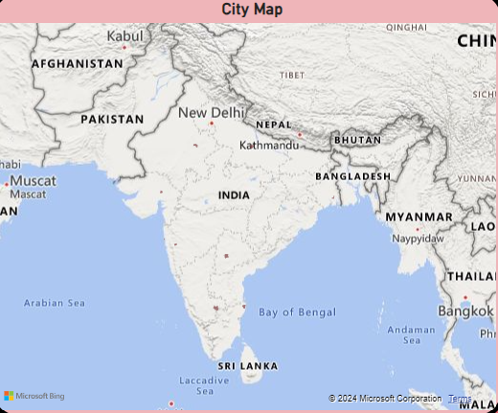
Cities Included in the Survey
Chennai
Bangalore
Delhi
Pune
Ahmedabad
Jaipur
Kolkata
Mumbai
Lucknow
Hyderabad

Slide 4
City Wise Visuals And KPI’s

Slide 5
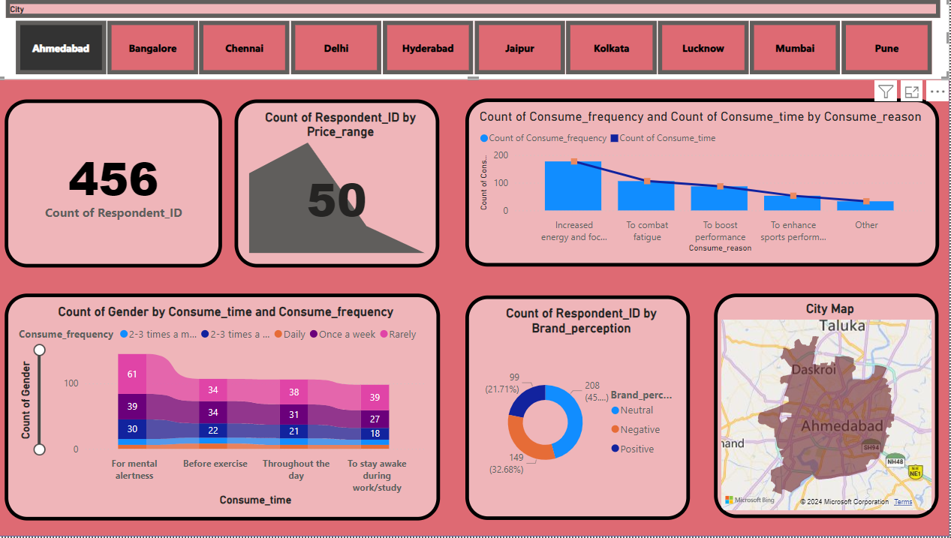
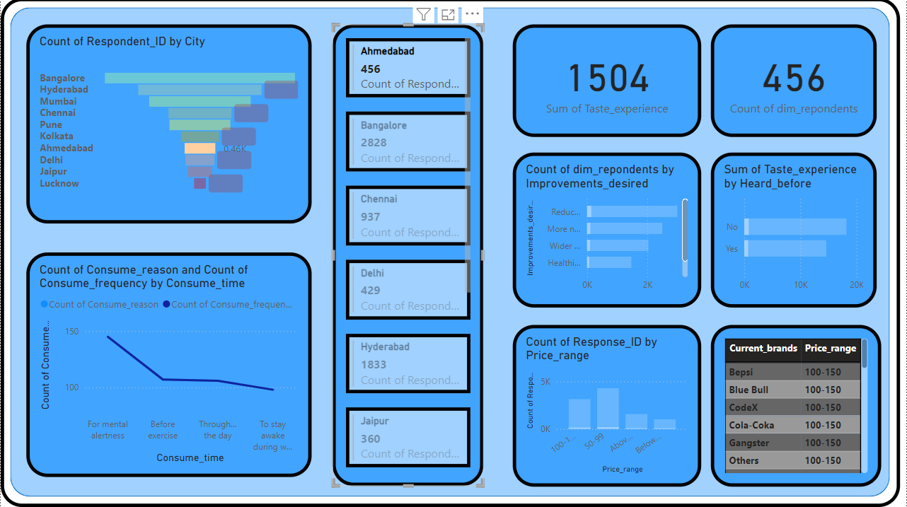
Ahmedabad

Slide 6
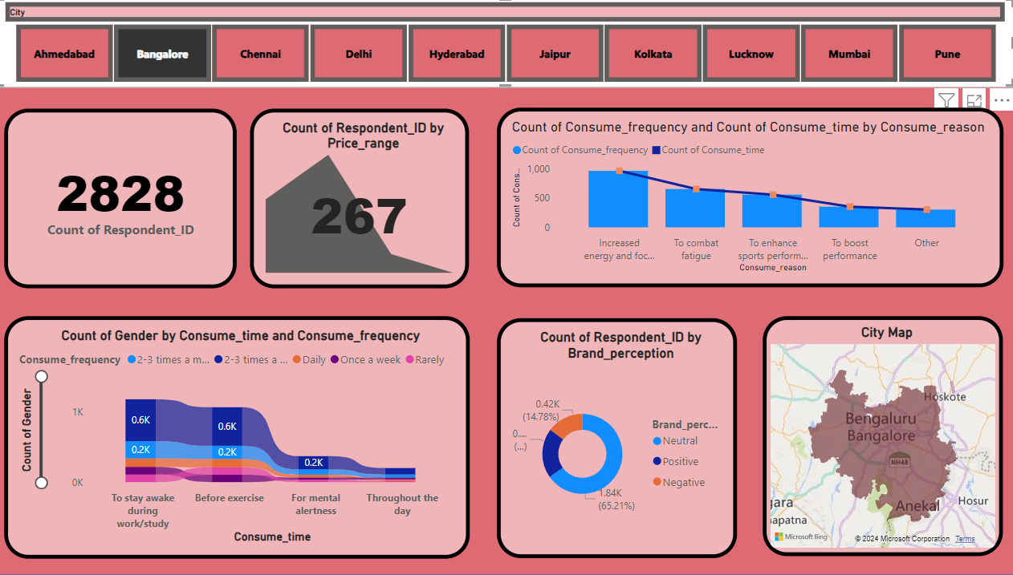
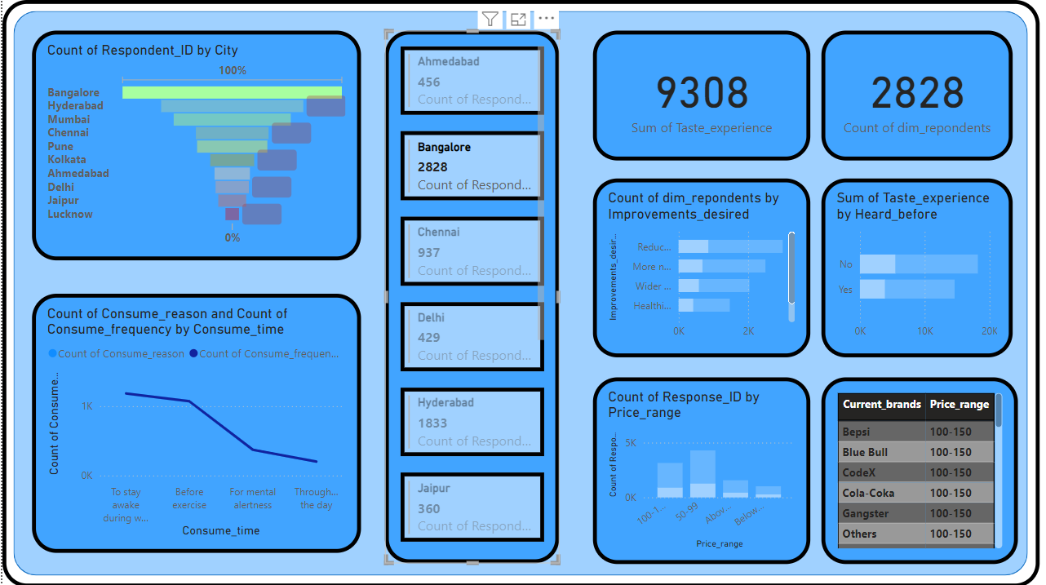
Bangalore

Slide 7
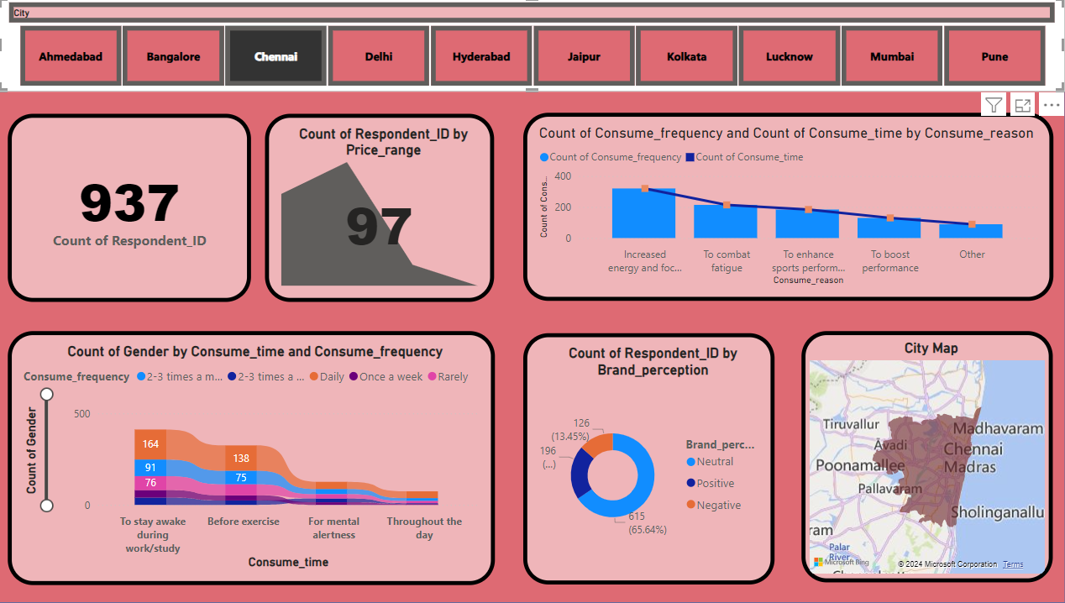
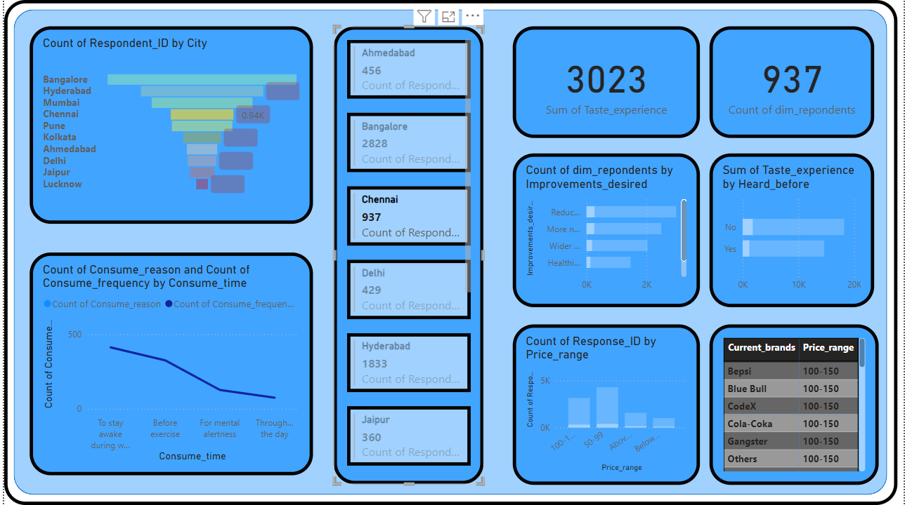
Chennai

Slide 8
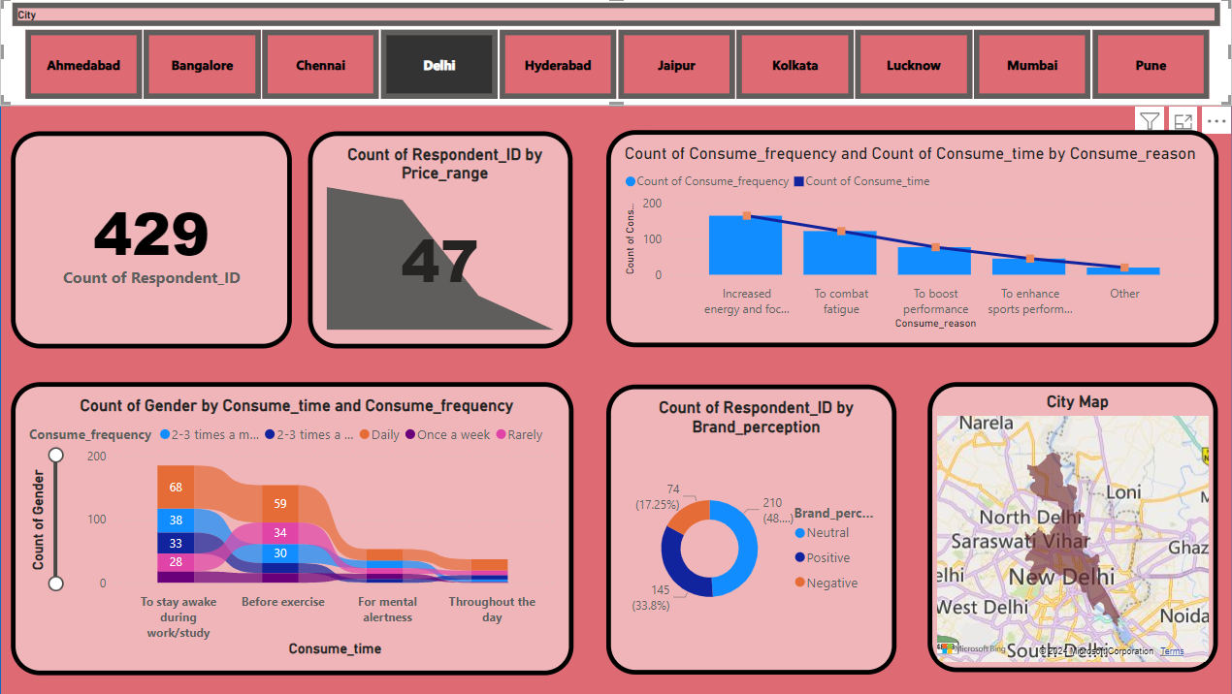
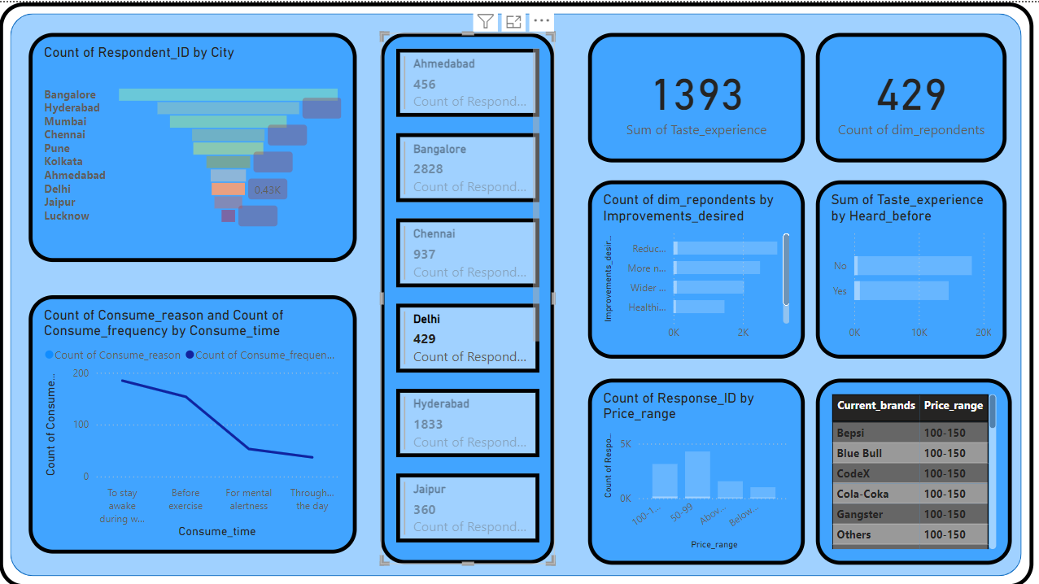
Delhi

Slide 9
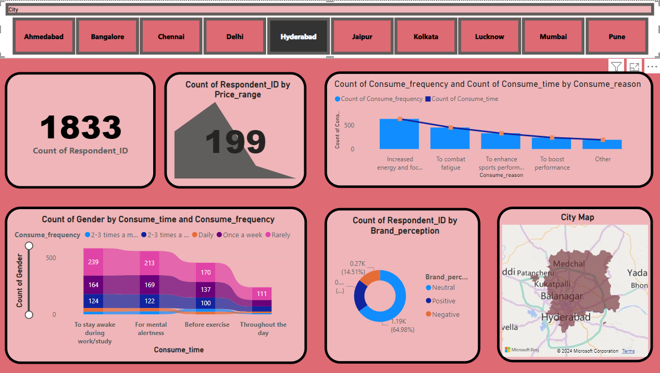
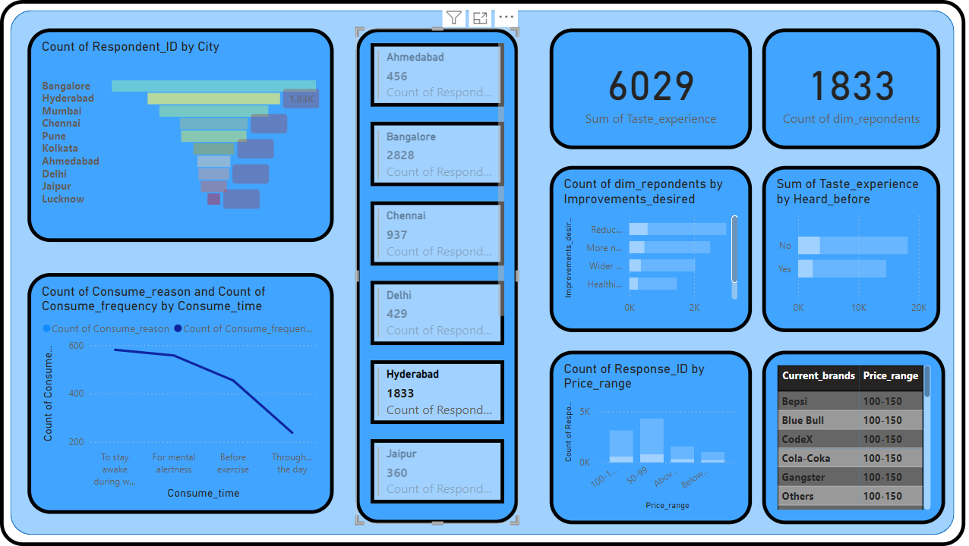
Hyderabad

Slide 10
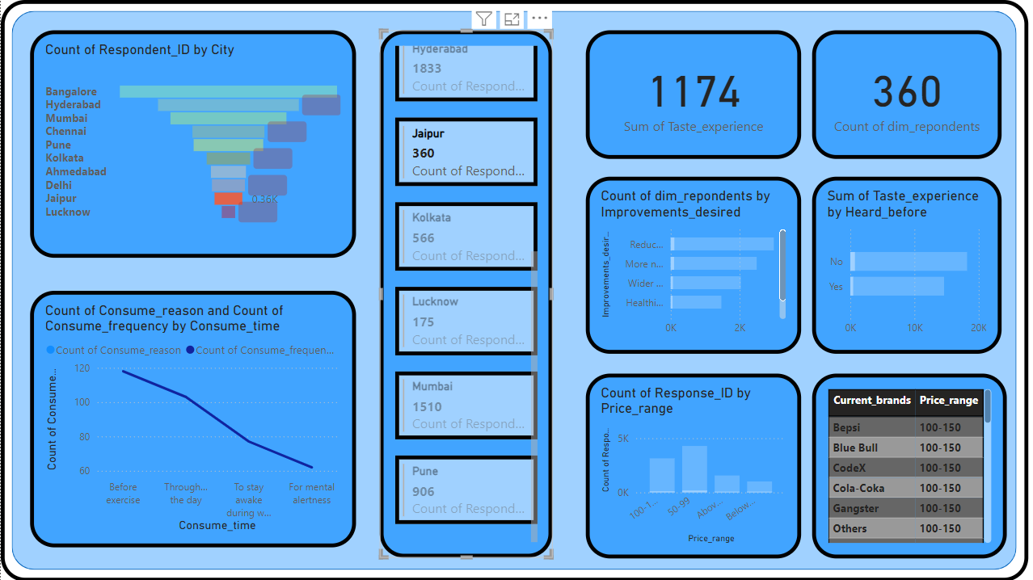
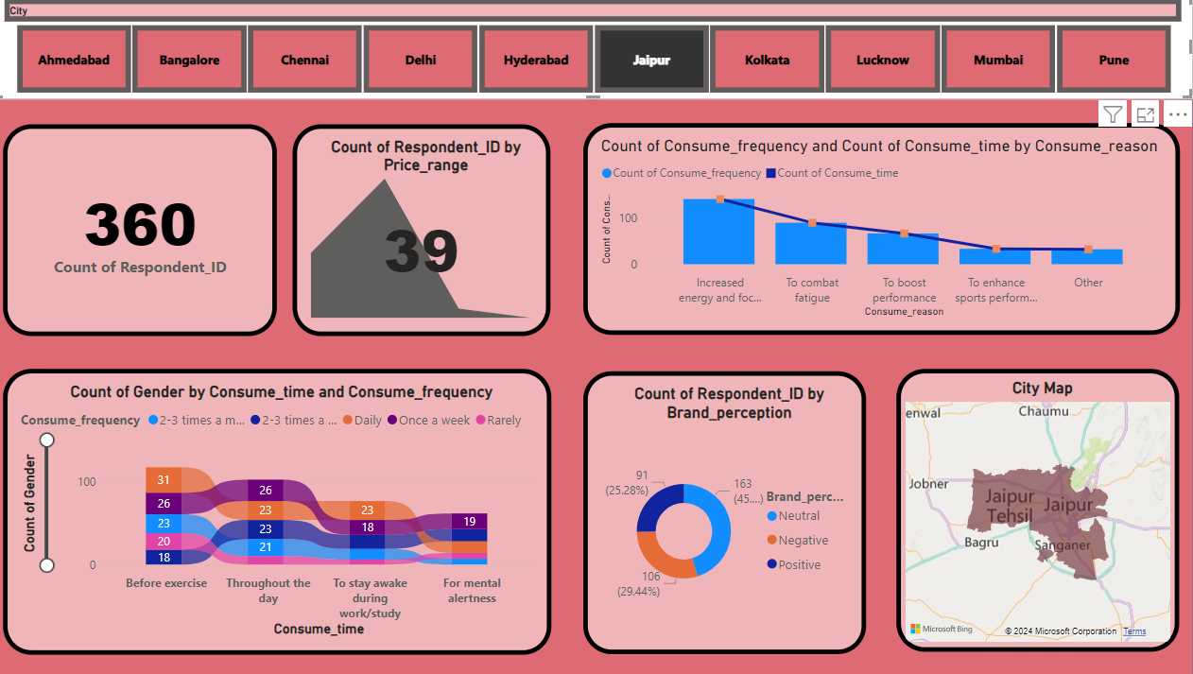
Jaipur

Slide 11
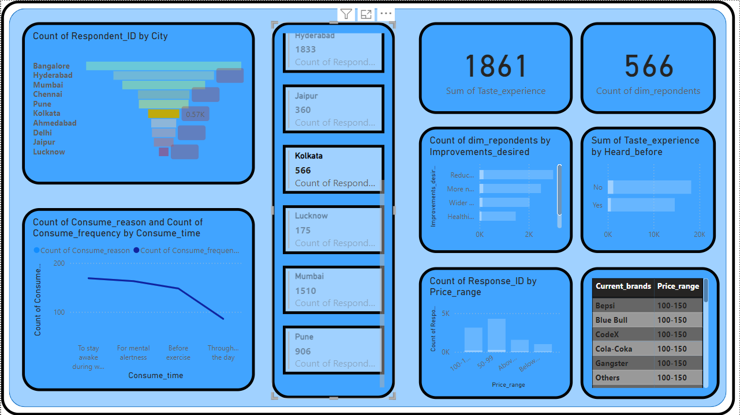
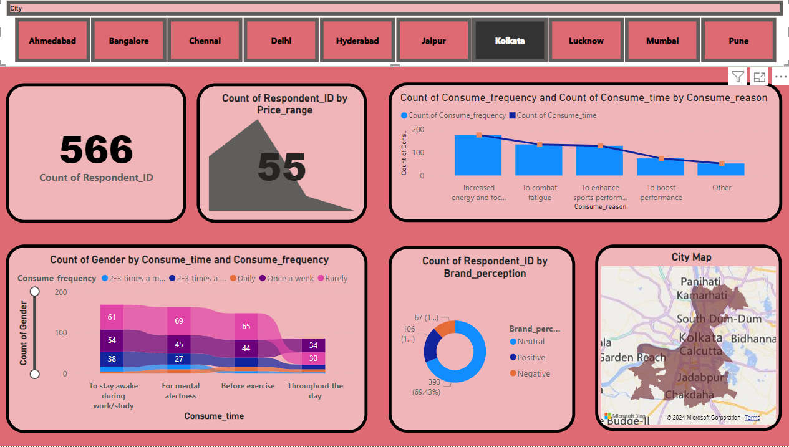
Kolkata

Slide 12
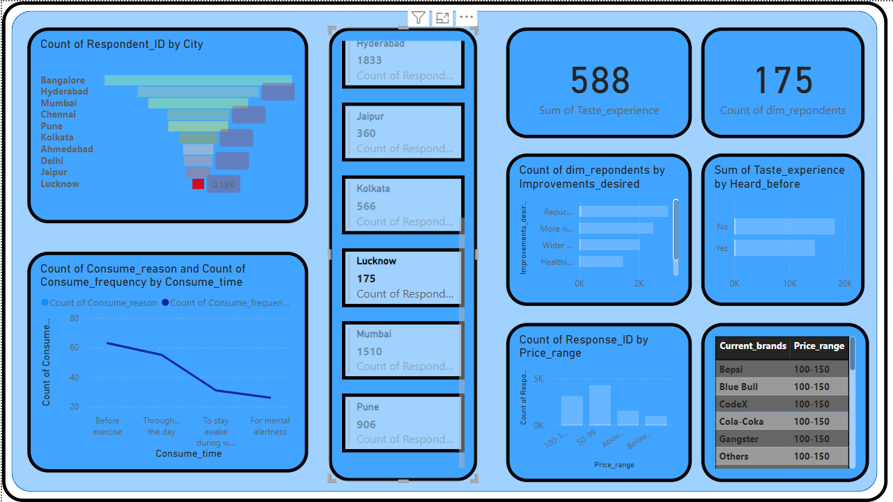
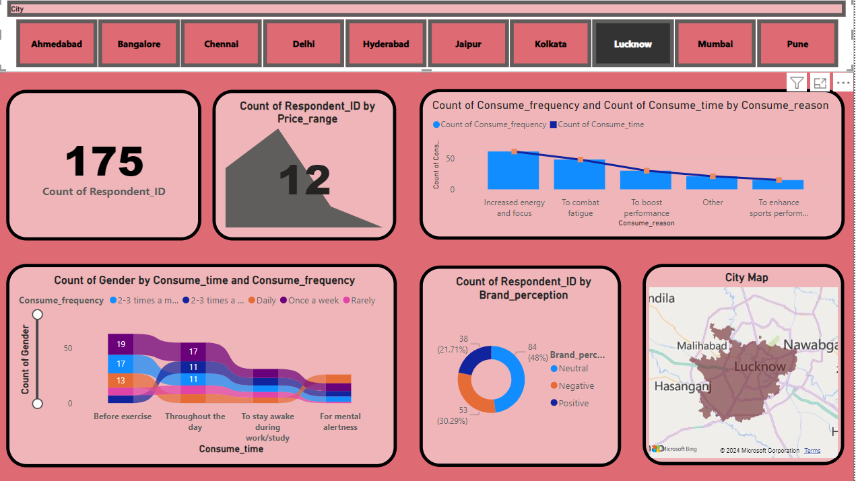
Lucknow

Slide 13
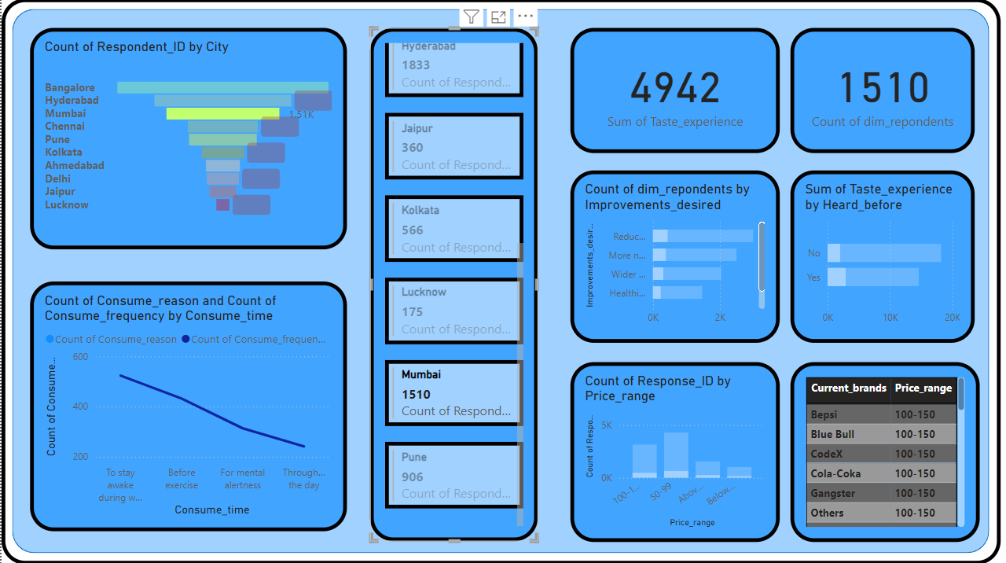
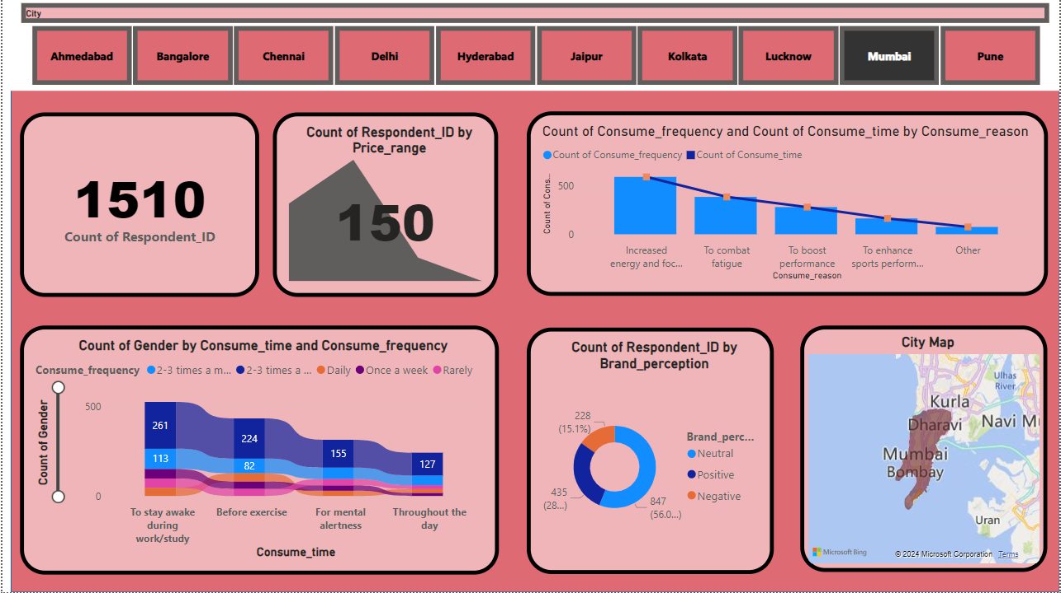
Mumbai

Slide 14

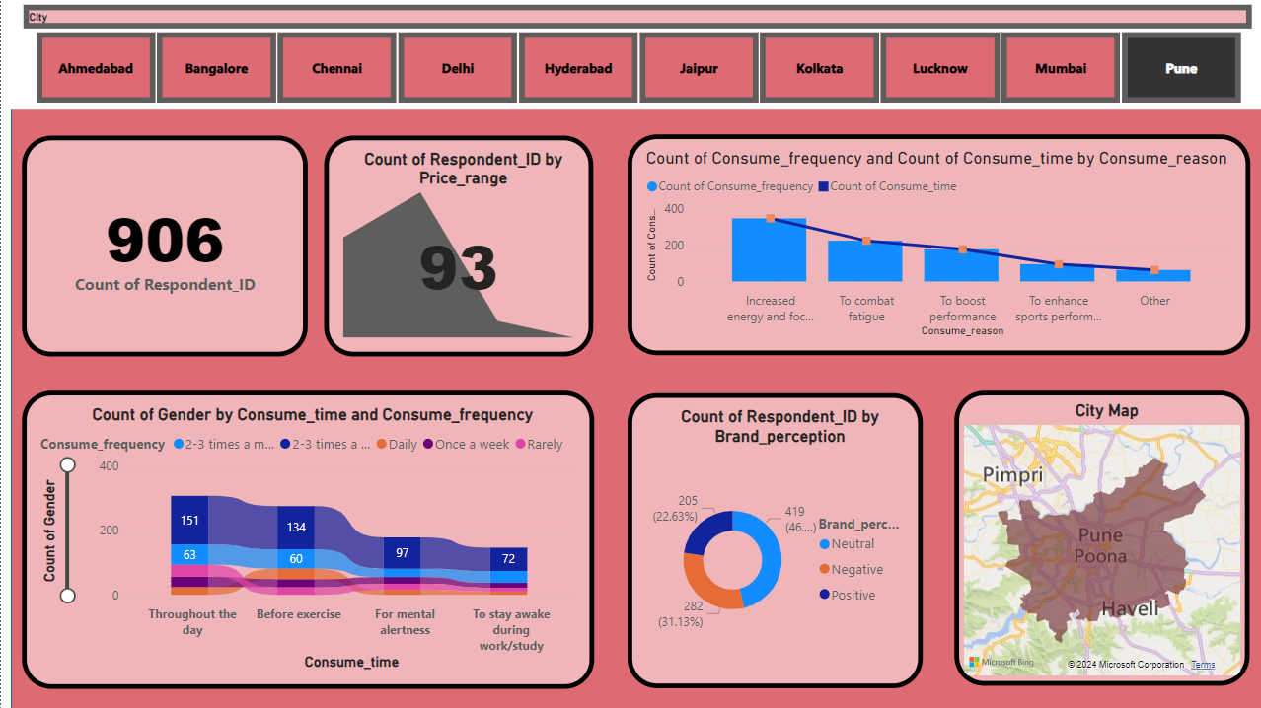
Pune

Slide 15
Thank You
By:- Akshit Maheshwari

